Slide 1
EECT 101-50C Lab Notebook
ELECTRONIC PROJECTS
Spring 2015
Eh Doh Lwe
5-6-15

Slide 2
Table of Contents
Lab 1 – Test Equipment Intro and Resistors 3
Lab 2 – Resistors, DMM, Ohm’s Law 9
Lab 3 – Resistors, Multisim, Ohm’s Law 16
Lab 4 – Test Equipment 1 Basics 21
Lab 5 – Test Equipment 2, Capacitors, Inductors 30
Lab 6 – Learn to solder 40
Lab 7 – CD-1 Checkout and First Solder Kit 44
Lab 8 – 555 Timer Chip 50
Lab 9 – Filters 55
Lab 10 – Square Wave to Sine Wave 61
Lab 11 – Troubleshoot Home Electronics/ Test 7400 Series Chips 66
Lab 12 – Lissajous Pattern and Home Electronic 71
Lab 13 – AC to DC Power Supplies 75
Lab 14 – ESD 81
Lab 15 – Testing Soldering Kit 87
Lab 16 – Soldering 94

Slide 3
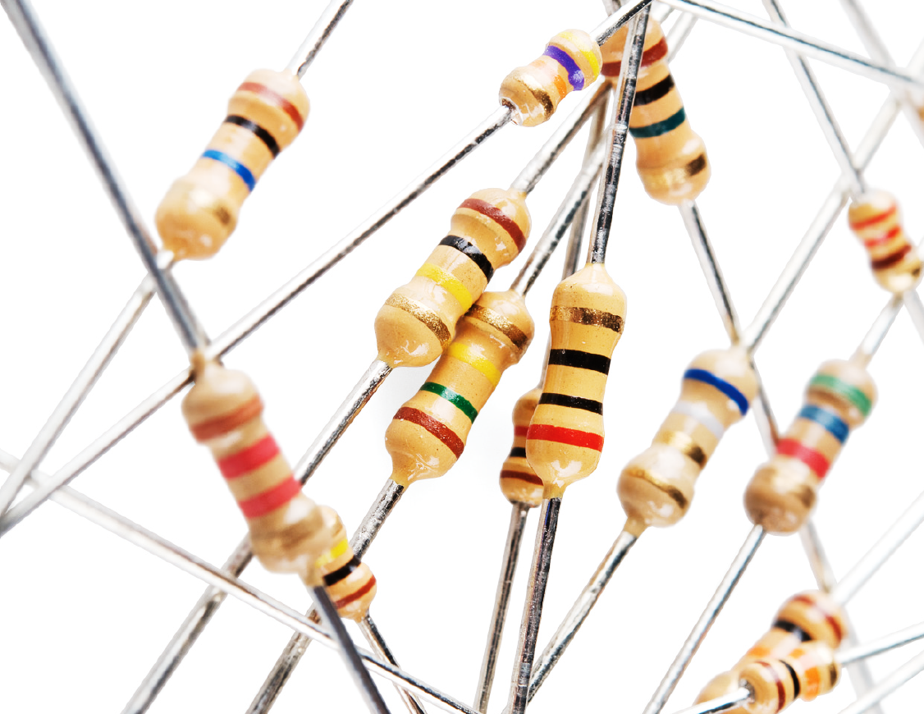
Lab 1 – Test Equipment Intro and Resistors

Slide 4
Lab 1 – Test Equipment Intro and Resistors
Objective
  Learn the resistor color code and brief intro to Ohm's Law.
Equipment and Material
  Multimeter Elvis 3 Resistors, 3 LEDs, and breadboard
Brand: GW instek Model: NI Elvis II+ 1 k ohm
Model #: GDM8245 Part # : 198570-02L 330 ohm
SN: CL860332 Serial : 166C8F1 39 k ohm
Research and Information
  Videos tutorials at www.ivytechengineering.com

Slide 5
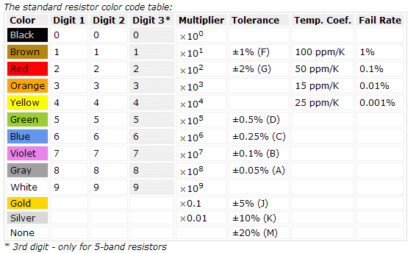
Resistor color code
Got this from Google Image

Slide 6
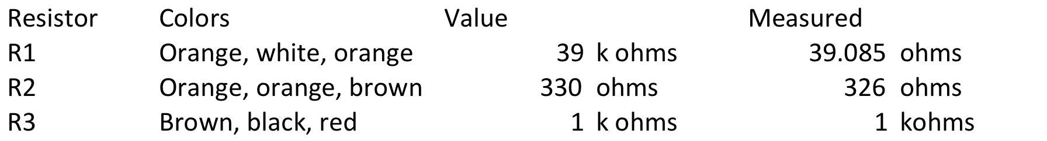
Verify and Measurements of Resistors
S

Slide 7
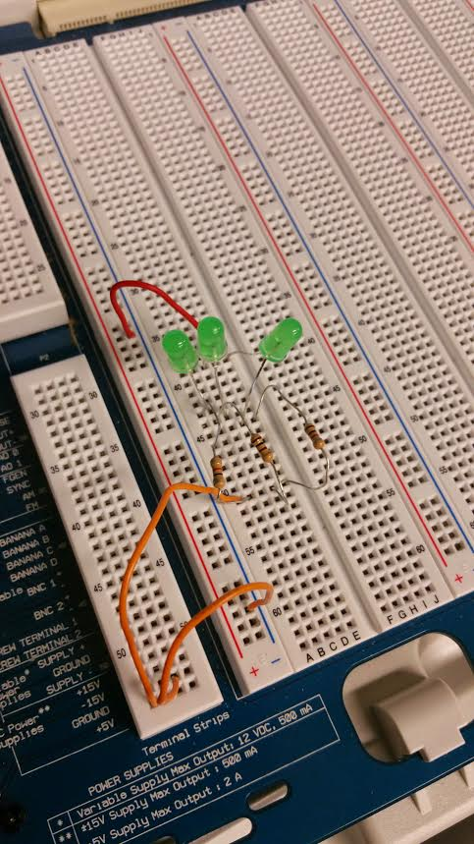
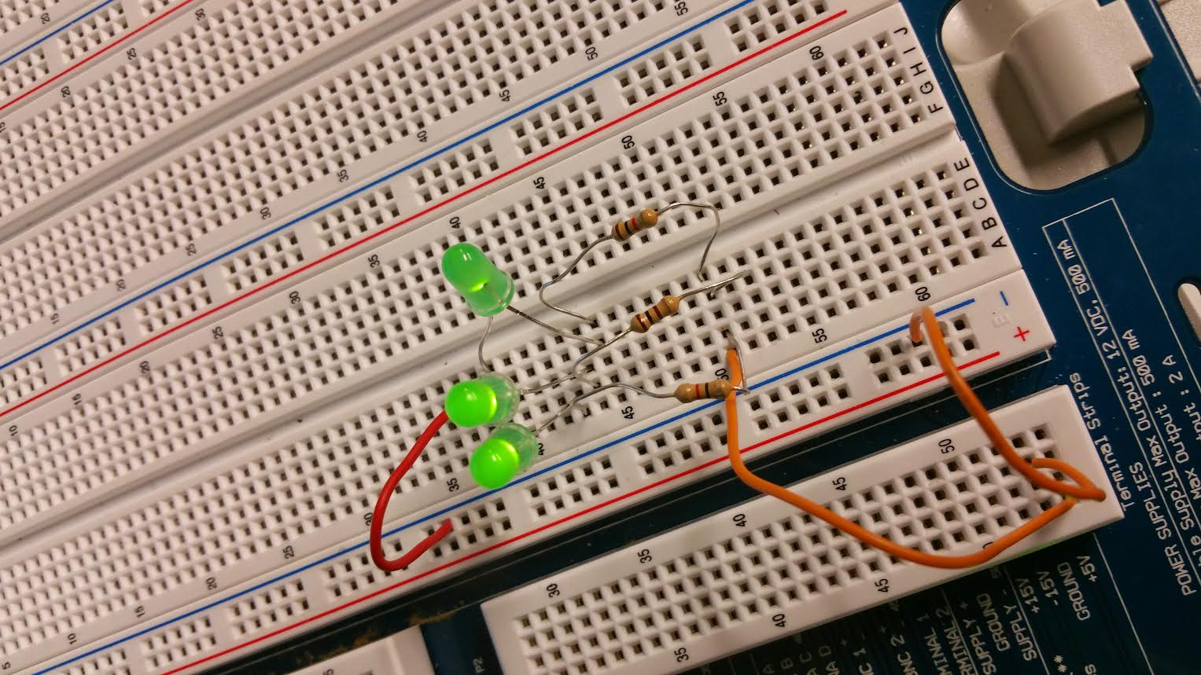
Lab 1 – Test Equipment Intro and Resistors
Using a DMM to measure 3 resistors and verify if within tolerance.
Power off

Slide 8
Lab 1 – Summary and Conclusion
  We looked at the resistor color band to tell the value then we used DMM to measured the 3 resistors and verified the values.
  After hooking up the wire and placed components in Elvis board, we turn on the power and the LED lit up.

Slide 9
Lab 2 – Resistors and Ohm’s Law

Slide 10
Lab 2 – Resistors and Ohm’s Law
Objective
    To understand how resistors work in Series and Parallel
Equipment and Material
    5 different resistors, NI Elvis II+ Board, DMM
  Multimeter Elvis 5 Resistors
Brand: GW instek Model: NI Elvis II+ 1 k ohms 2.2K ohms
Model #: GDM8245 Part # : 198570-02L 330 ohms 4.7k ohms
SN: CL860332 Serial : 166C8F1 820 ohms
Research and Information
  Tutorials at www.ivytechengineering.com and YouTube
  First, learn the resistor color code: http://www.youtube.com/watch?v=kvQBhXo_tF0
  Tutorials at http://www.ivytechengineering.com/ee_stuff/ee101_vids_resistors.html
  Ohm’s Law: https://www.youtube.com/watch?v=d34-VKc2cyY

Slide 11
Measurements
 | Resistor Resistance | Actual Resistance
R1 | 330 ohms | 324.39 ohms
R2 | 820 ohms | 817.7 ohms
R3 | 2.2K | 2.15K
R4 | 4.7K | 4.65K
R5 | 1K | .985K
 | Caculated Resistance | Actual Resistance
Series 1 | 1.489 mA | 1.44 mA
Series 2 | 493.156 mA | 494.84 mA
Parallel 1 | 23.4 mA | 23.4 mA
Parallel 2 | 28.38 mA | 27.6 mA

Slide 12
Lab 2 – Detail and Procedure
Measure 5 different resistors and compare expected (color codes) with actual (measured) values to verify tolerance. Also calculate expected and measure all 5 in series and all 5 in parallel. Then add a 5V source and calculate expected and measure voltage drop across series and parallel and expected current (using Ohm's Law) and actual current (measured).

Slide 13
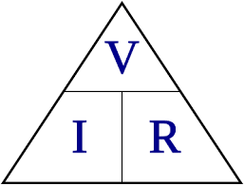
Ohm’s Law and Formula
Current are the same in series
In series, to find the total resistance, we add all the values of how many resistors are in the circuit.
To find total resistance in parallel circuit, we use product over sum.
Series Parallel
Rtotal = R1 + R2 + R3 + ... RT= 1/((1/R1)+(1/R2)+…)

Slide 14
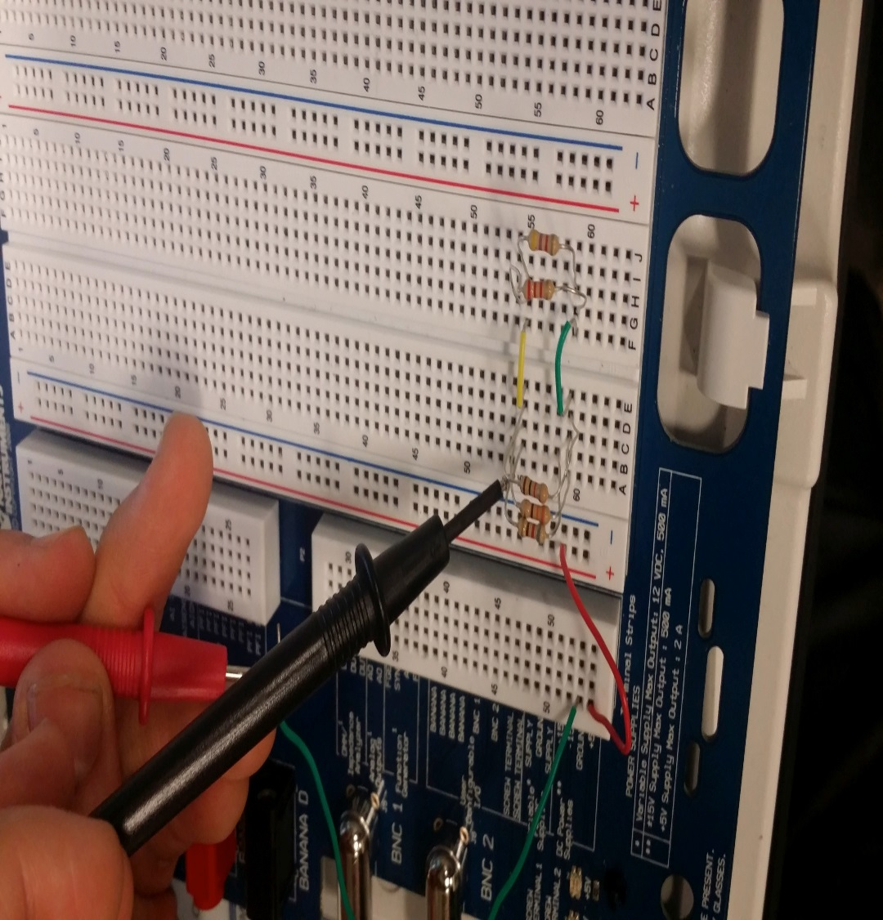
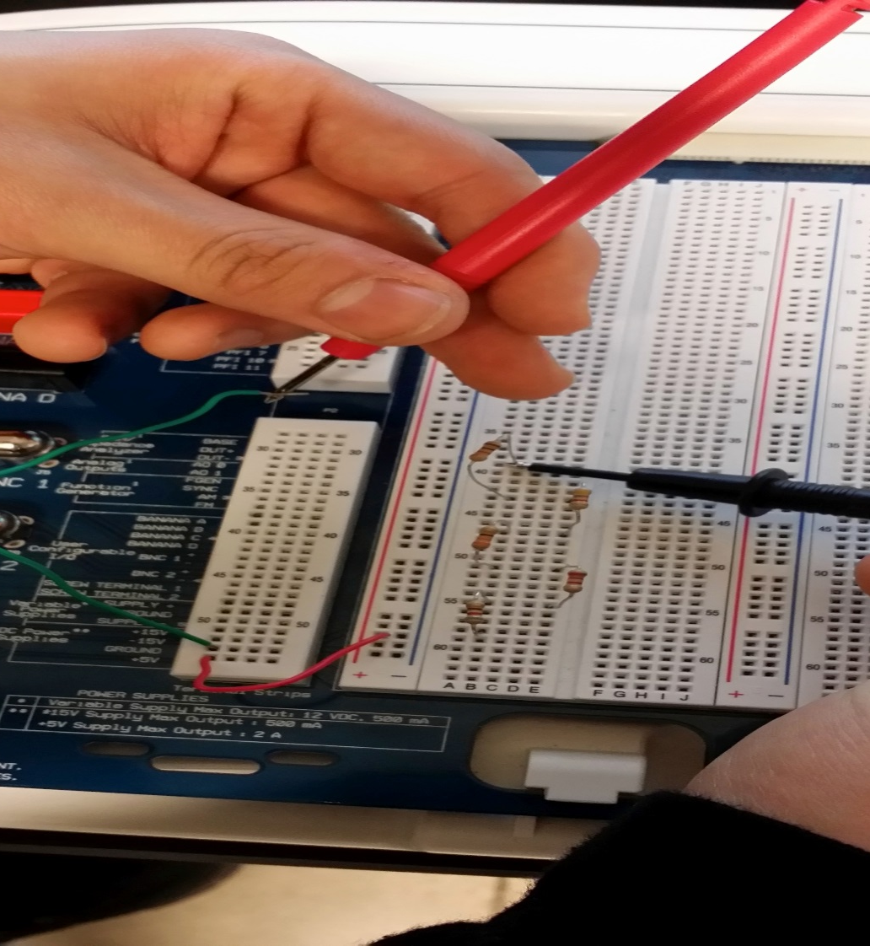
Pictures

Slide 15
Summary and Conclusion
Before wiring it up on the Elvis board, we calculated what the resistance would be both series and parallel.
The measurements of the resistance came out to be as we calculated.

Slide 16
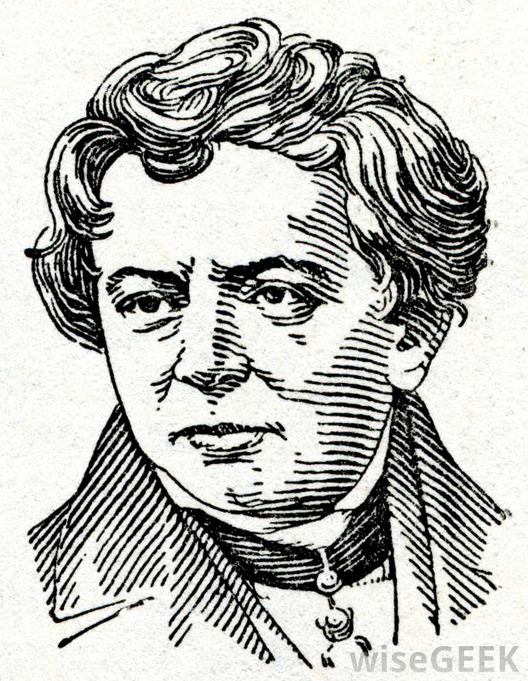
Lab 3 - Resistors, Multisim, Ohm’s Law

Slide 17
Lab 3 – Resistors, Multisim, Ohm’s Law
Objective
    To create circuit in multism to test if last week measurements came up to be the same or close
Equipment and Material
    Multism
Research and Information
  Multism tutorials at www.ivytechengineering.com

Slide 18
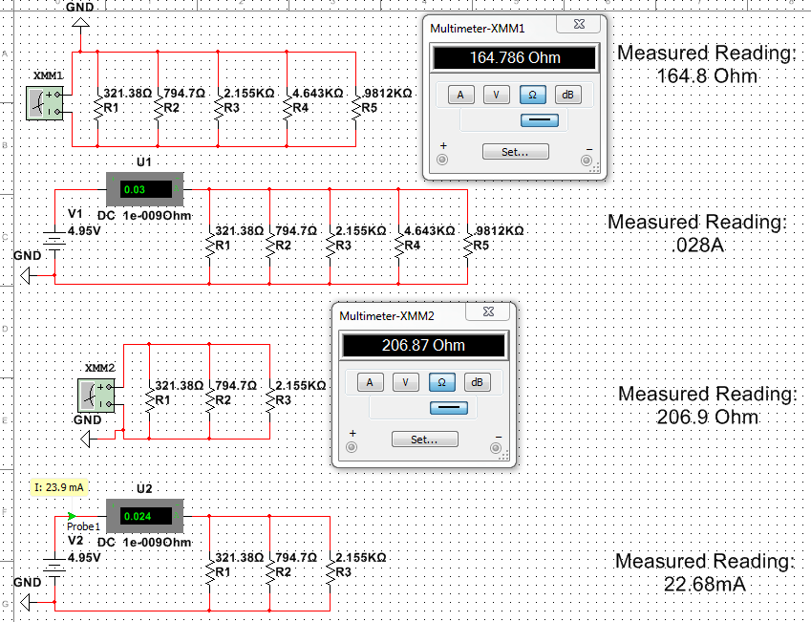
Parallel

Slide 19
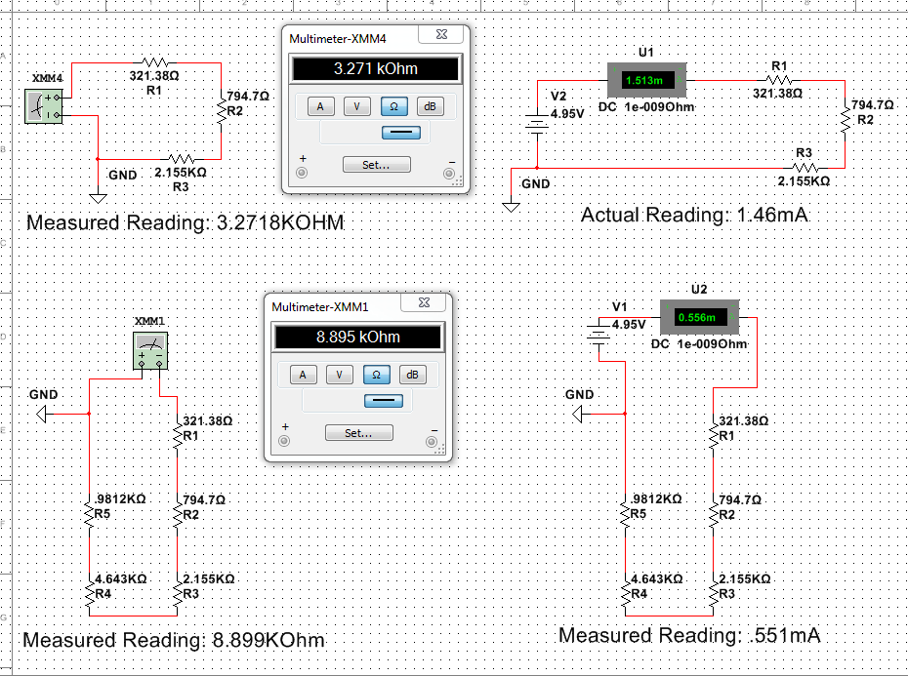
Series

Slide 20
Summary and Conclusion
Created circuit in Multism to see if the measurements came out to be the same from last two weeks and it did.
In Multism, we tested the current, voltage, and resistance for both series and parallel circuit.

Slide 21
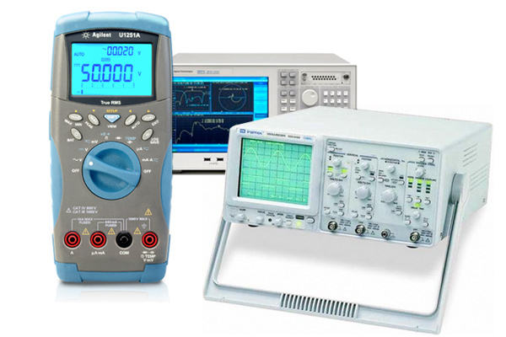
Lab 4 – Test Equipment 1 Basics

Slide 22
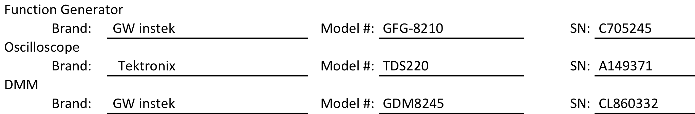
Lab 4 – Test Equipment 1 Basics
Objective
    To know how to use Function Generator and Oscilloscope.
Equipment and Material
Research and Information
  Tutorial videos at www.ivytechengineering.com

Slide 23
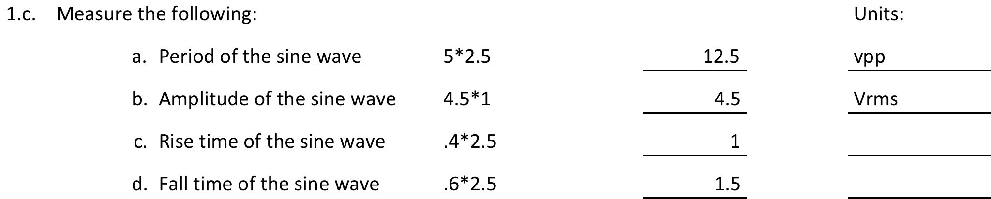
Detail and Procedure

Slide 24
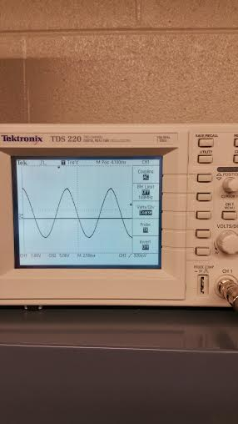
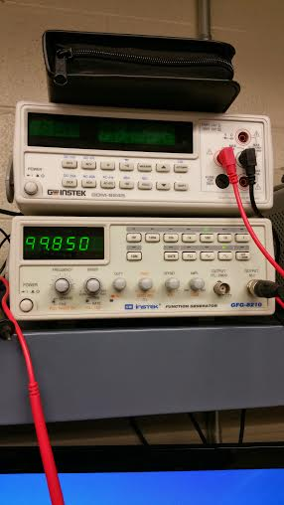
Pictures from #1
1B
1A

Slide 25
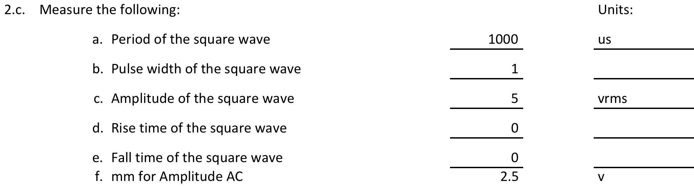
Detail and Procedure Continued

Slide 26
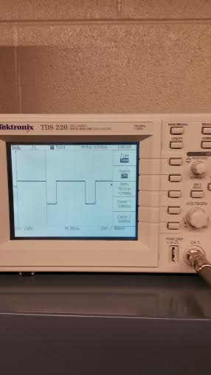
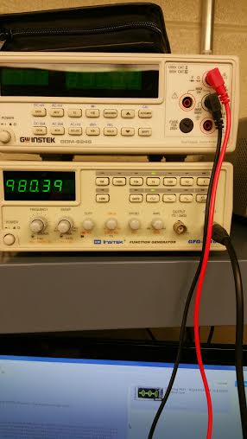
Pictures

Slide 27
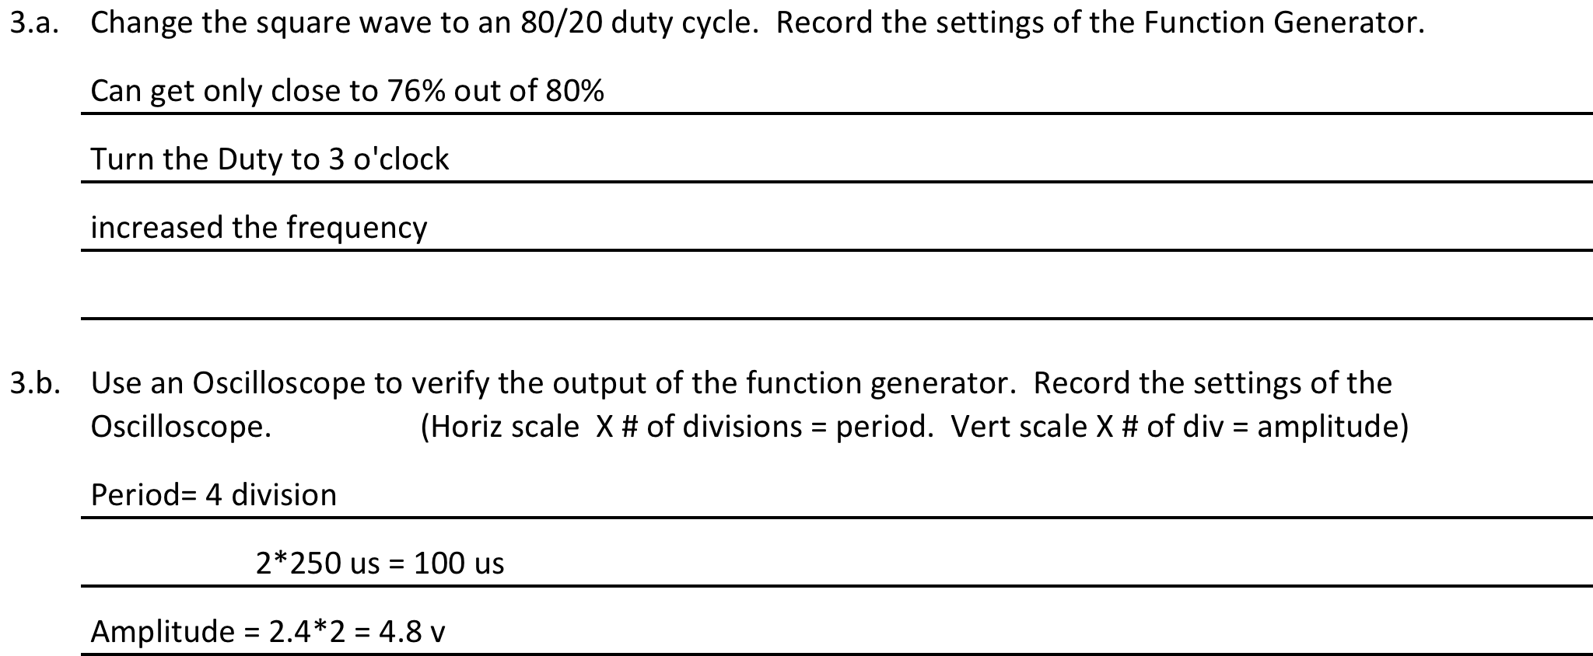
Continued
3.c. | Measure the following: |  |  |  |  |  | Units:
 | a. | Period of the square wave |  |  | 1000 |  | us
 | b. | Pulse width of the square wave |  |  | 0.3
 | c. | Amplitude of the square wave |  |  | 4.96 |  | vpp
 | d. | Rise time of the square wave |  |  | 0
 | e. | Fall time of the square wave |  |  | 0

Slide 28
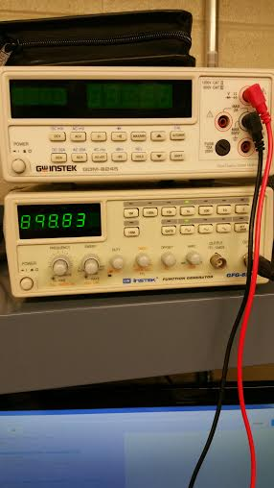
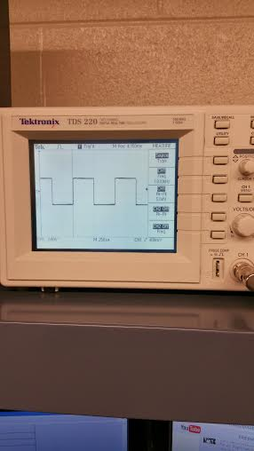
Pictures

Slide 29
Conclusion
I’ve learned that frequency and period inverse to each other.
I thought I know what to do when I watched the video but once I started doing it, I just got confused and didn’t go well as I thought I knew it would be in the video.
I am struggling with Oscilloscope and I need more experiment with it.

Slide 30
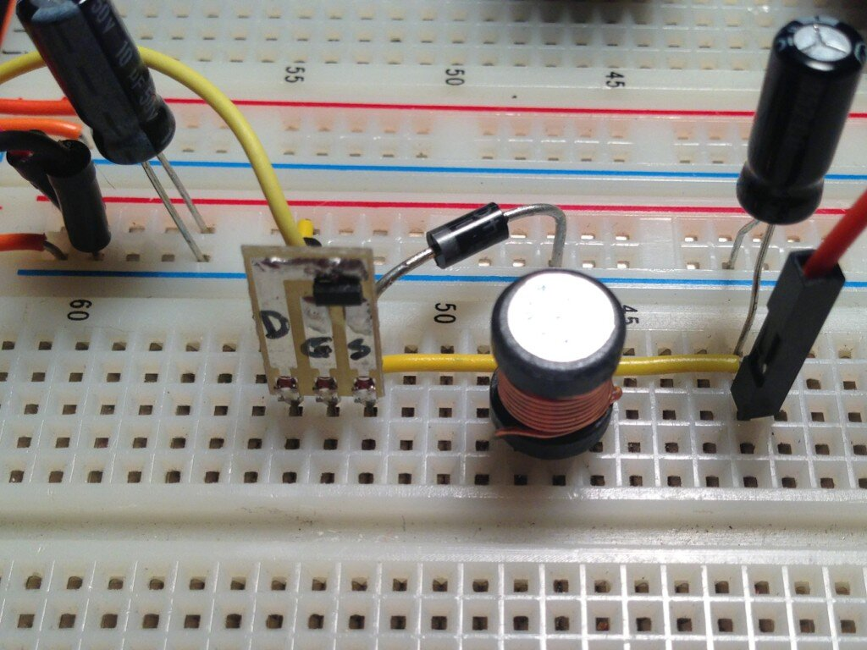
Lab 5 – Test Equipment 2, Capacitors, Inductors

Slide 31
Lab 5 – Test Equipment 2, Capacitors, Inductors
Objective
    To learn about capacitors, inductors, and know how to use LCR meter to measure capacitor and inductors including custom hand wound inductors.
Equipment and Material
LCR Meter, 28AWG magnet wire, core, and capacitor
Research and Information
  Videos at www.ivytechengineering.com
  videos provided in week 5 folder
  To find T-69 and T-80 go to www.amidoncorp.com

Slide 32
Equipment

Slide 33
Lab 5 – Research Info
Capacitor stores energy in electric field.
Inductor stores energy in magnetic field.
They reverse to each other.
Capacitor resist voltage and inductor resist current.
Capacitor block AC in parallel.
If capacitor charge increase, voltage increase.
Inductor takes time to store and release energy. Higher frequency, the longer time.
Higher inductance value, the more inductor will resist sudden change in current.

Slide 34
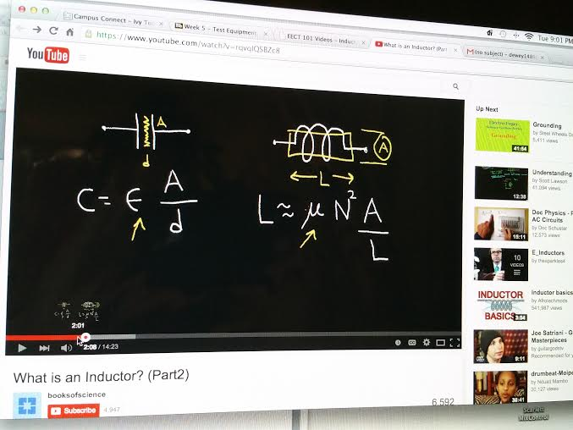
Equations
Capacitor: Inductor:
Parallel= ADD Product over sum
Series= Product over sum ADD

Slide 35
Lab 5 – Detail and Procedure
  Research how to use an LCR Meter and all about inductors.
  2. Measured 4 capacitors, 3 standard inductors
  3. Hand wound one core with 10 and 15 turns of 28AWG magnet wire and a different smaller core with 20 turns of wire.
  4. Measured the 3 hand-wound inductors.
  5. Share all measured values with the rest of the class and each person has to come up with statistical information on the measurements such as Mean, Standard Deviation, Min, Max.

Slide 36
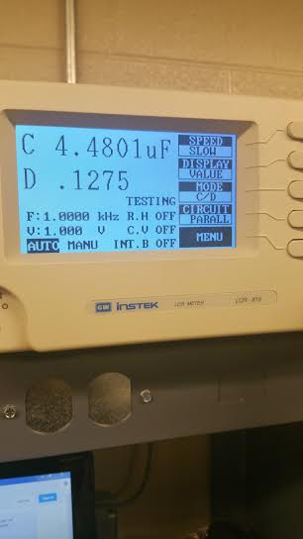
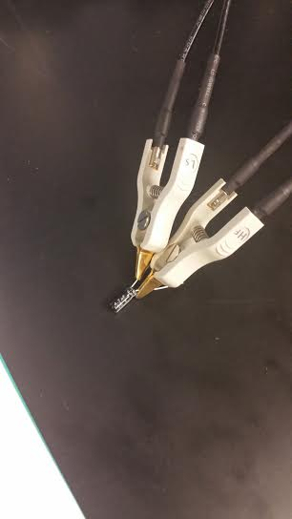
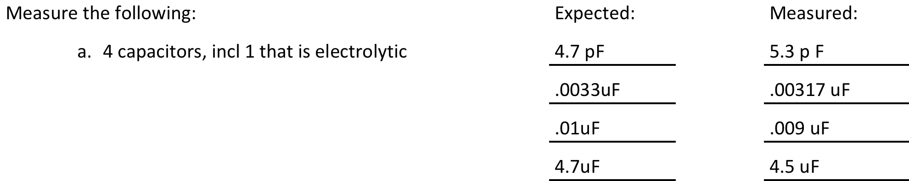
Guideline and Pictures

Slide 37
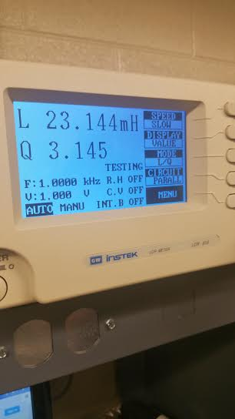
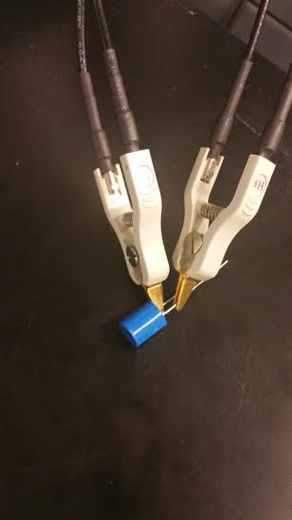
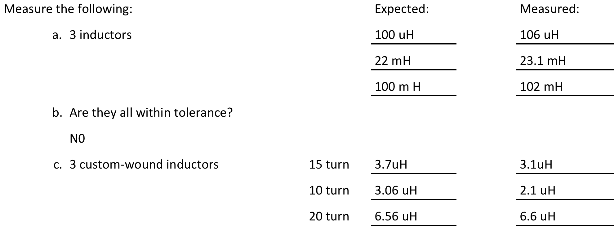
Guideline and Pictures
Pictures next slide

Slide 38
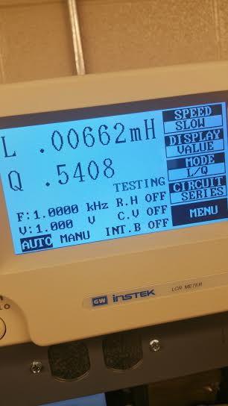
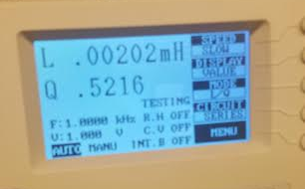
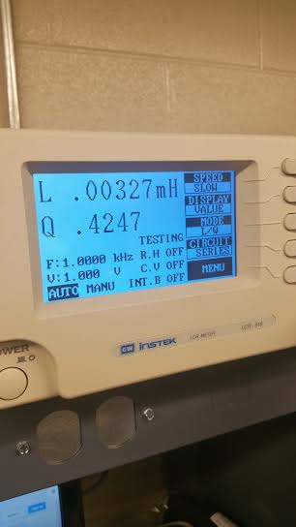
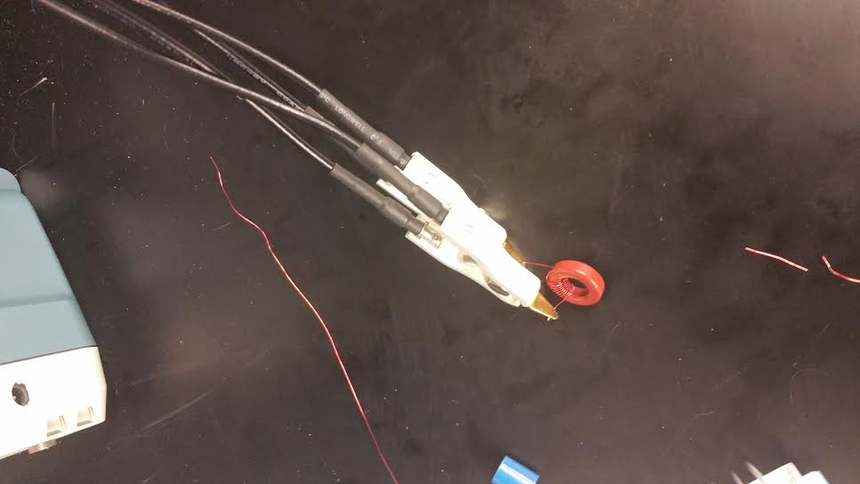
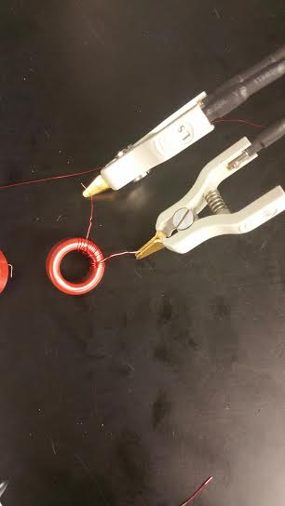
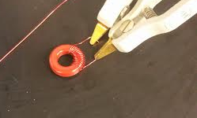
Pictures custom wound inductors

Slide 39
Summary and Conclusion
Pretty easy lab. The only hard part was having to do the math to figure out the value after wrapping the wire around the core. We had to measure length and find out the diameter before we could plug it in our equation.

Slide 40
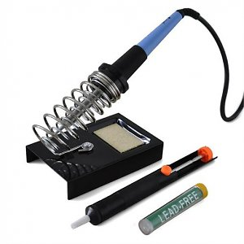
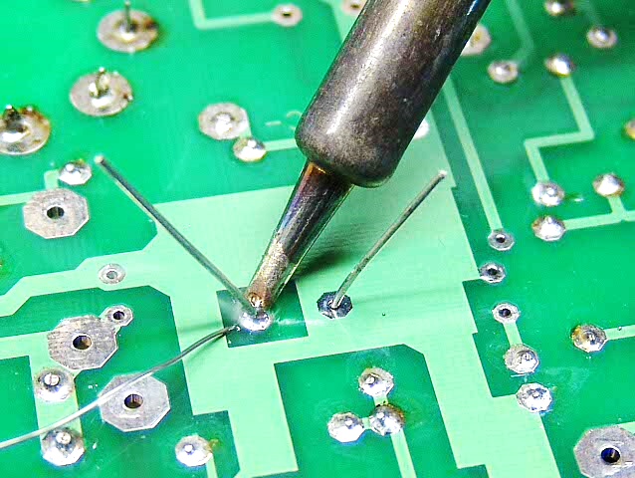
Lab 6 – Learn to Solder

Slide 41
Lab 6 – Learn to Solder
Objective
    To gain experience soldering electronic component
Equipment and Material
    Soldering Iron, Solder, Safety Goggles
Research and Information
  Soldering tutorials at www.ivytechengineering.com
  YouTube videos at https://www.youtube.com/watch?v=oqV2xU1fee8
  https://www.youtube.com/watch?v=-lnRf2biz50

Slide 42
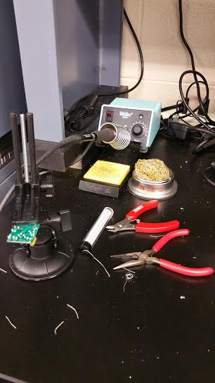
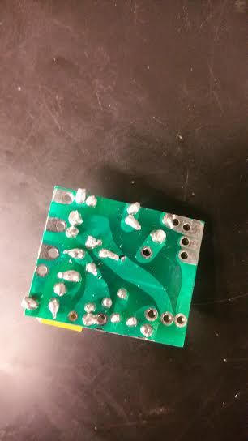
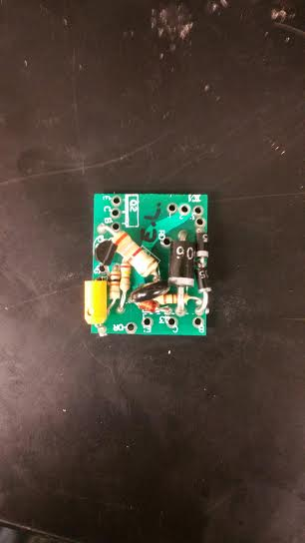
Soldering Pictures

Slide 43
Conclusion
  Saw what transistors and diode looks like.
  I’ve learned that the bigger the component, the longer to heat.
  The tool to remove solder rarely works.
  It was a fun soldering, I really enjoyed it.

Slide 44

Lab 7 – CD-1 Checkout and First Solder Kit

Slide 45
Objective
  Use knowledge and experience from last week's soldering activity to build kit. Then, compare soldering quality of this week's kit to last week's soldering.
  Work in teams and open up the old E&L Instruments CMOS/TTL CD-1 boards (from 1980s) to identify all the different components.
Equipment and Material
    Soldering Iron, Solder, Safety Goggles
Research and Information
  Soldering tutorials at www.ivytechengineering.com
  Used previous knowledge on soldering the kit.

Slide 46
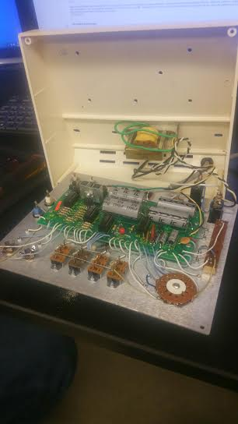
Components found in CMOS/TTL CD-1
 |  |  |  |  |  |  |  | 2/25/2015 |  | Victor Bultemeier
 | Electical Component | Quantity |  |  | Mechanical Component | Quantity |  |  |  | Eh Doh Lwe
 | 100K Variable Resistor | 1 |  |  | LED | 4
 | IC | 4 |  |  | Binding Jacks | 2 |  |  |  | Serial Number
 | Transistors | 3 |  |  | Pulser Button | 2 |  |  |  | 38346
 | Transformer | 1 |  |  | Clock Knob | 1
 | Diode 200V (1N4003) | 4 |  |  | Logic switch | 4
 | 1K Resistor | 9 |  |  | Power Input | 1
 | Transistor w/ sync | 1 |  |  | Power Switch | 1
 | 470K Resistor | 4 |  |  | Voltage Adjustment | 1
 | 150 Resistor | 4 |  |  | TTL Switch | 1
 | 15 Resistor | 1 |  |  | BNC Connectors | 2
 | 4.7K Resistor | 1
 | 2200 Micro Farad Cap (16V) | 3
 | 2200 Micro Farad Cap (35V) | 1
 | .1 Micro Farad Cap | 2
 | 330 Micro Farad Cap (10V) | 1
 | 470 Resistor | 1
 | .01 Cap | 2
 | .003 Cap | 1
 | 150 D Capacitor | 1
 | 10 Micro farad Cap | 1
 | 85Celsius Capacitor | 1
 | 2 Ohm Resistor | 1
 | 350 C Capacitor | 1

Slide 47
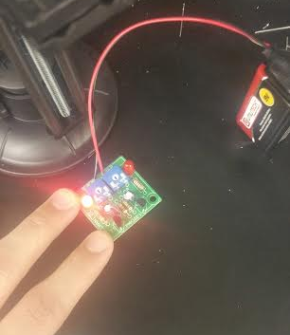
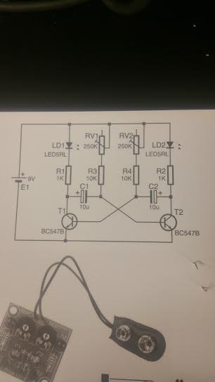
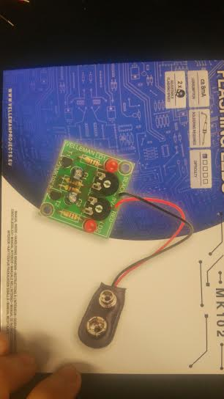
Schematic and picture for Flashing Light

Slide 48
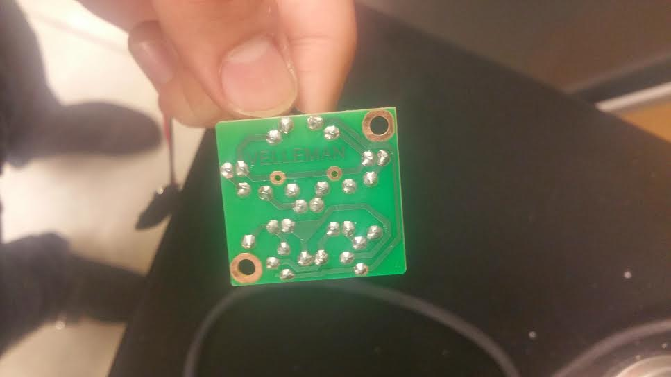
Comparing Last week & this week Soldering
Last Week
This Week

Slide 49
Conclusion
This week soldering was much better than last week.
Felt like the next soldering would be improved also.
Just need to be patience and take time on each one.
Hand was shaken and hope there is way to prevent that.
The kit worked and I didn’t burn any components.

Slide 50
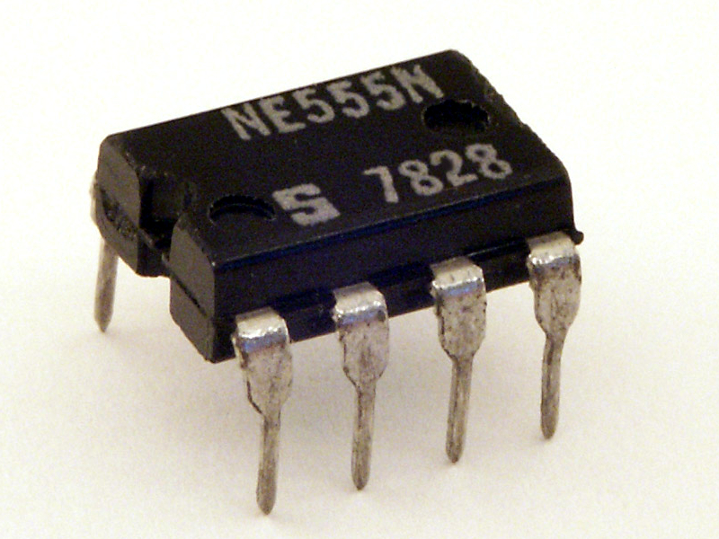
Lab 8 – 555 Timer Chip

Slide 51
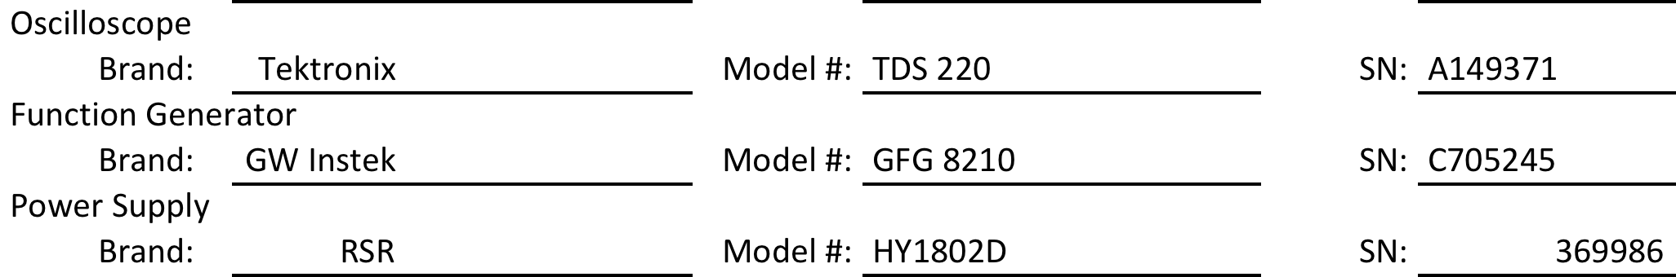
Lab 8 – 555 Timer Chip
Objective
  Researched all about the 555 Timer chip and breadboard a typical circuit to flash an LED at 0.5Hz, 1Hz, 2Hz.
Equipment and Material
555 timer chip, breadboard, LED, (3) Resistors, Cap
Research and Information
  Datasheet at www.ivytechengineering.com and source athttps://www.youtube.com/watch?v=Vbz_MKT7KnI
  Set up video at https://www.youtube.com/watch?v=Vbz_MKT7KnI

Slide 52
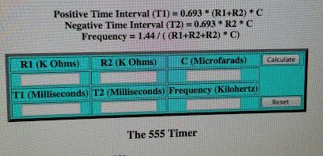
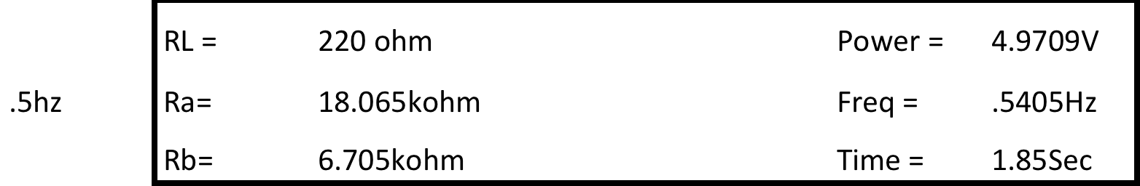



Procedure
Formula

Slide 53





Pictures

Slide 54
Summary and Conclusion
Took awhile to find the right video for the set up. Once found it, we had to write down which input go to what pin on the chip.
Took some time also to find the right value for resistor and capacitor even though we have the online formula.
Verifying the output in Oscilloscope was the hard part for us because we are not clearly understood how it works yet.
Other than that, we were able to accomplished the requirements using 555 timer chip.

Slide 55

Lab 9 – Filters

Slide 56
Lab 9 – Filters
Objective
  build an RC lowpass filter and measure the frequency response from 10 Hz to 100,000 Hz.
Equipment and Material
Research and Information
  YouTube video at https://www.youtube.com/watch?v=WZN42JO_kFo
  Used datasheet in week 9 folder
Resistor and Capacitor

Slide 57
Research Info
Capacitor varies reversely with frequency
Low frequency, large capacitor reactance and resistor’s voltage drop.
      Vout= Vin*(R2/R1+R2)
Equation:

Slide 58

Passive Filters Document

Slide 59


Pictures

Slide 60
Conclusion
  What we did wrong was didn’t keep the input to 1 Volt, that was why the graph wasn’t right when we graphed it.
  Other thing we’ve learned was that to make sure resistor is not shorted. This was also another problem we had.
  This lab was simple and short but it was just boring when we had to keep a record in the Excel.
  Need more research on what is the use of low pass filter and when do we use it in real life.

Slide 61

Lab 10 – Square Wave to Sine Wave

Slide 62
Lab 10 – Square Wave to Sine Wave
Objective
    Converting square wave to sine wave
Equipment and Material
  (6) 100ohm resistors, (6) 22uF Capacitors
Research and Information
  YouTube video at https://www.youtube.com/watch?v=IIDp0nfPrts

Slide 63


Schematic

Slide 64



Pictures

Slide 65
Summary and Conclusion
Looking for a clear video and a right one took awhile.
Once found it, I started to get the equipment and components to do the demonstration right away but It wasn’t possible because I wouldn’t know how many resistors or capacitors I need to give me a perfect sine wave in the Oscilloscope. So I started building the circuit in Multism just like everyone else which was a lot helpful.
Noticed that I didn’t have a perfect sine wave due to the lack of capacitor we have so I only used 4 instead of 6.

Slide 66

Lab 11 –Test 7400 Series Chips

Slide 67
Lab 11 – Test 7400 Series Chips
Objective
    testing 7400 series chips.
Equipment and Material
    Breadboard, 100ohm resistor, LED, jumpers, SN7404, SN7406, 5v power DC supply
Research and Information
  Datasheet at www.ivytechengineering.com

Slide 68



SN7404 (Inverter)
Switch
Low input for High output

Slide 69


SN7406 (Inverter Buffer)

Slide 70
Summary and Conclusion
Used LED to verify the output.
Move input and output accordingly to test.
All worked.
SN706 was a little tricky. LED needed resistors to limit current.

Slide 71

Lab 12 – Lissajous Pattern and Home Electronic

Slide 72
Lab 12 – Lissajous Pattern and Home electronic
Objective
  to display a circle or ellipse on an oscilloscope, then demonstrate in the lab.
Equipment and Material
Research and Information
  Video at https://www.youtube.com/watch?v=t6nGiBzGLD8
  https://www.youtube.com/watch?v=pSyitNgy8hE

Slide 73



Pictures
Home Electronic

Slide 74
Summary and Conclusion
  Had to use two function generator to create a circle. One channel acts as an X axis and the other as Y axis.
  Needed to have 90 degrees for perfect circle but we didn’t get that.
  Didn’t have a perfect circle but we were there.
  After demonstrate the Lissajous pattern, I worked on the home electronic I brought it. Couldn’t get it fix because I couldn’t find a schematic online to help me see what was wrong with it.

Slide 75

Lab 13 –AC to DC Power Supplies

Slide 76
Lab 13 – AC to DC Power Supplies
Objective
    Convert AC to DC
Equipment and Material
(4) IN4148 diodes, 100uF Capacitor, 5V AC
Research and Information
  Video tutorials at https://www.youtube.com/watch?v=cyhzpFqXwdA

Slide 77
Details and Procedures
Build and demonstrate in lab but use a function generator for the sine wave input at 60 Hz, 5.6V pk.
Show on the oscilloscope the input on channel 1 and the output on channel 2 which should be about 5V DC.

Slide 78



Pictures
Optional

Slide 79

Schematic

Slide 80
Summary and Conclusion
This was build in Multism first then wired it up after we saw the result in Multism was correct.
To see if it was matched with the result in Multism, we look at it through the Oscilloscope to confirm it.
Found out that it need to be around 12 v range for 5v output.
The optional I chose to do was cutting the foam and placed it in the chips’ cup holder.

Slide 81
Lab 14– ESD

Slide 82
Lab 14– ESD
Objective
  Find out how it can affect electronic devices and some of the ways to prevent or minimize ESD for safe handling.
Equipment and Material
    Resistor, LED, Jumpers
Research and Information
  Video at https://www.youtube.com/watch?v=yHijVbN5CYY
  Info at http://www.computerhope.com/esd.htm

Slide 83
Info about ESD
is sudden flow of electricity between two object.
Commonly build up when there is friction between 2 material like walking on rug or removing plastic package.
Occur when object with static electricity charge near the object with low charge.

Slide 84
Approximate voltage generated from basic home items
a) masking tape =
b) scotch tape =
c) a wool sweater =
d) walking across the carpet in the winter time =

Slide 85


LED Testing

Slide 86
Conclusion
Many ways you can prevent ESD by touching metal stuff, grounding yourself, buy ESD strap, and many more.
All the LED tested were worked and found only 1 flashing LED in the container.

Slide 87
Lab 15– Testing Soldering Kit

Slide 88
Lab 15 – Testing Soldering Kit
Objective
    Test and see if the components in the kit works before soldering next week.
Equipment and Material
    DMM, LCR, Chip tester, (12) 3.3K resistors, 1N4148 (diode), 555 timer(4v2302), CD4015BE (IC), (2) 1uF Capacitor, (1) 10nF Capacitor, pot, and push button.
Research and Information
  Testing 555 timer https://www.youtube.com/watch?v=Vbz_MKT7KnI

Slide 89



Pictures from testing
555 Timer
LED
(IC) CD4015BE

Slide 90








Pictures from testing cont.
3.3k Resistors
10nF Capacitor
1uF Capacitor
Diode

Slide 91
Summary and Conclusion
  All the components work and hopefully nothing wrong with them when I solder them on to the board next week so that I don’t have to troubleshoot them.
  It didn’t take long to test out the component except the 555 timer chip because I had to look up on how to test it out, but once I found the video, it took me about 5 minutes to see if the chip works or not and it worked.

Slide 92



Modern Car electronic testing
555 timer chip

Slide 93
Summary and Conclusion
  Since I already tested out the 555 timer from my soldering kit, all I did to test out this chip from the car was by doing the same thing. I could have just replaced the chip but I didn’t know I had to test another 555 timer chip so by the time I knew I had to do another one, I already took out wires and put stuff away so I had to rewired again, but didn’t take me long since I had done it once.
  The chip worked and to confirmed it, I hooked up the oscilloscope to the output and that was when I knew for sure that it worked.
  My skill at using Oscilloscope was sucks and I need more practice on it

Slide 94
Lab 16 - Soldering

Slide 95
Lab 16 –Soldering
Objective
    Soldering the last kit
Equipment and Material
    DMM, LCR, Chip tester, (12) 3.3K resistors, 1N4148 (diode), 555 timer(4v2302), CD4015BE (IC), (2) 1uF Capacitor, (1) 10nF Capacitor, pot, and push button.
Research and Information
  Knowledge from previous soldering

Slide 96

Schematic

Slide 97

OUTLINE
s

Slide 98


Pictures

Slide 99

Video

Slide 100
Conclusion
I did good but I think my second soldering was a little better this one.
Since haven’t done soldering for awhile, the first 2 or 3 components I soldered didn’t came out that good.
Overall it worked which I thought it wouldn’t because in some components I spent a little more time on heating it which would burn it but I didn’t so that was nice.

